Slide 1

CPE/CSC 486: Human-Computer Interaction
Franz J. Kurfess
Professor
Computer Science Department
California Polytechnic State University
San Luis Obispo, CA, U.S.A.
fkurfess@calpoly.edu

Slide 2


Usage of the Slides
these slides are intended for the students of my CPE/CSC 486 “Human-Computer Interaction” class at Cal Poly SLO
some of them are based on the “Interaction Design” textbook
www.id-book.com
if you want to use them outside of my class, please let me know (fkurfess@calpoly.edu)
some of them are based on other sources, which are identified at the bottom of the respective slide
©2011
© Franz J. Kurfess

Slide 3
Course Overview
Introduction
Cognitive Foundations
Interaction Spaces
Input-Output Devices
Interaction Styles
Interaction with Mobile Devices
Speech-Based Interaction
User Assistance
Natural User Interfaces
Case Studies
Project Presentations

Slide 4
Chapter Overview Interaction Styles
Motivation
Objectives
Terminology
Batch Systems
Command-Line Interfaces
Full-Screen Interfaces
Menus
Forms
Direct Manipulation Interfaces
WIMPs
User Assistance
Interaction through Speech
Interaction with Mobile Devices

Slide 5
Interaction Styles
in CSC 484
there is a similar chapter in the CSC 484 class
follows the Rogers, Preece, Sharp textbook
see http://users.csc.calpoly.edu/~fkurfess/Courses/484/W17/Administration/Schedule.html, Week 4

Slide 6
Motivation
the way interaction with computers is performed depends on available technology on one hand, but also on different methods and usage styles for a particular technology
the change in interaction style from command-line to graphical user interface has contributed considerably to the popularity of personal computers
for a given task and user population, different interaction styles may make the difference between success, acceptance, or failure of a product

Slide 7
Objectives
to know the advantages and drawbacks of the most often used interaction styles, in particular command-based vs. graphical user interfaces
to be familiar with evaluation criteria for a comparison of different interaction styles
to be able to select an appropriate interaction style for a specific task, environment, and user population
to be exposed to emerging interaction styles like natural language, gestures, or intelligent agents

Slide 8
Evaluation Criteria
name and briefly describe at least three interaction styles
e.g. batch, command line, GUI
apply three criteria to the evaluation and comparison of interaction styles
representation, operation, navigation
discussion of potential advantages and drawbacks of emerging interaction styles
e.g. usability, user control, computational overhead, prevention of errors
© Franz J. Kurfess

Slide 9
Interaction
exchange of information between user and system
actions of the user that change the status of the system
feedback to the user concerning actions of the system
requires translation between the intentions of the user and the actions of the system

Slide 10
Terminology
task
actions to be performed in order to solve a problem in an application domain
goal
desired output from a completed task
task analysis
identification of the problems space
in particular domain, goals, intentions, specific tasks
user language (task language)
describes the problem to be solved in terms familiar to the user
system language (core language)
describes the functionality of the system in terms familiar to the designer or developer

Slide 11
Interaction Model
execution
establishing the goal
forming the intention
specifying the action sequence
executing the action
evaluation
perceiving the system state
interpreting the system state
evaluation of the system state
with respect to goals and intentions
[Norman, Dix]

Slide 12
Interaction Styles
term covers all of the ways that users interact with a computer system
also referred to as communication styles or dialog styles
represent alternative design strategies for the UI
each style offers its own way of organizing the system’s functionality, of managing the user’s inputs, and of presenting information
e.g. display-based interfaces -> menus, mice, windows, widgets, icons, buttons, function keys, etc.
provide a behavioral view of how the user communicates with the system
“look and feel”
[Mustillo]

Slide 13
Evaluation Criteria for Interaction Styles
representational
how a system “looks and feels” (graphical), or “sounds and feels” (speech)
operational
how a system links sequences of operations together
maps the representations used onto its functions
navigational
awareness of what users can do at each stage
how they can move through the system
[Mustillo]

Slide 14
Interaction Framework
components
system, user, input, output
input and output together form the interface
each of the components may have its own language to describe the objects and actions it is concerned with
[Dix]

Slide 15
Interaction Framework
[Dix]

Slide 16
Interactive Cycle
Presentation
Observation
Performance
Articulation
[Dix]

Slide 17
Interaction Cycle
see also Google spreadsheet version

Slide 18
Translations Between Components
articulation
user translates task intentions into the input language
performance
input language is translated into stimuli for the system
presentation
system activities are translated into output language
observation
output language is translated into the user’s task model

Slide 19
Example: Light in a Room
controlling the lighting in a room
articulation: “I’m going to bed now, so I better turn off the light in the living room. To do this, I need to flip the switch.”
task language: turn lights on/off
input language: flip switch
system language: close/open circuit for light bulbs
output language: lights on/off

Slide 20
Example (cont)
translations
articulation
user decides to turn on the light, and flips a switch
performance
flipped switch closes the circuit
presentation
light bulb emits light
observation
user notices that the light is on
frequent problem
multiple switches in large rooms

Slide 21
Practical Exercise
Describe the languages and translations for the interactions required to open a document containing the third homework for this class.

Slide 22
Practical Exercise: Open a Document
languages
task language: activities described in natural language
input language: user commands, file names
system language: system calls, OS objects
output language: commands for an output device
e.g. screen, or PostScript for a printer
© Franz J. Kurfess

Slide 23
Practical Exercise (cont.)
translations
articulation
user translates “document with the third homework” into the corresponding file name
double-click on file “HW-3.html”
performance
system translates user-level commands and parameters into system-level commands and objects
system calls to invoke an application program compatible with HW-3.html’s type, and to load the file
presentation
system translates internal representation into a form suitable for output devices
display of the file on the screen
observation
user interprets the information shown on the output device
© Franz J. Kurfess

Slide 24
Practical Exercise: Digital vs. Analog Clocks
Describe and compare the languages and translations used for setting digital and analog clocks. What are frequent problems with the two device types and their languages or translations?
languages
task language
input language
system language
output language
translations
articulation
performance
presentation
observation

Slide 25
Practical Exercise: Digital vs. Analog Clocks
Describe and compare the languages and translations used for setting digital and analog clocks. What are frequent problems with the two device types and their languages or translations?
languages
task language
set time to a certain value
input language
wheel vs. buttons
system language
mechanical movement vs. ICs
output language
minute and hour hands vs. LCD display

Slide 26
Practical Exercise (cont.)
translations
articulation
turn wheel / press buttons
performance
clock translates input actions into modified display
presentation
new time setting is displayed
observation
user translates hand positions or numbers into time

Slide 27
Practical Exercise (cont.)
problems
which way do you turn the wheel
which button do you press, how often, in which combination
turning the time “back” on a digital clock is frequently impossible

Slide 28
Exercise: Select Example
Identify an activity or scenario to illustrate interaction styles
languages
task, input, system, output
translations
articulation, performance, presentation, observation
problems
© Franz J. Kurfess

Slide 29
<Student Submissions>
© Franz J. Kurfess

Slide 30
Interaction Styles
Batch systems
Command line
Full-screen
Menus
Fill-in forms
Questions and answers
Direct manipulation interfaces
WIMP interfaces
Natural language interaction
Natural user interfaces

Slide 31
Batch Systems
first generation of user interfaces
interaction restricted to a single point in time
submission of a batch job as a single unit
user commands have to be specified before the result of any of them is made known to the user
work well for repetitive jobs (e.g., payroll processing, billing, etc.), and are still used today
Examples: Revenue Canada, Canada Post, Bell Canada.
drawbacks
not interactive
inflexible
[Mustillo]

Slide 32
Interlude: Personal History
the images in the following slides represent computer systems I used early in my career
IBM 360 or 370
small configuration for a mid-size company
I worked there as a high school summer intern, but wasn’t allowed anywhere near the computer
Telefunken TR440
main computer at the Technical University of Munich, 1977
NASCOM 2
computer kit based on Zilog Z80, ~1980
Three Rivers PERQ
graphics workstation for my MS Thesis documentation, ~1985
Symbolics Lisp Machine
AI research work station
Transputer parallel system
16 Transputer microprocessors connected as a torus
research on parallelization of logic programming
Atari ST1040
terminal to mini-computer
LaTeX workhorse for my PhD Thesis, ~1989

Slide 33
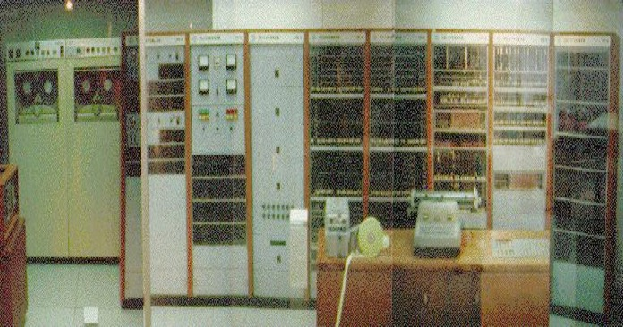
Example Batch Systems:
Telefunken TR 4
http://www.vaxman.de/historic_computers/telefunken/tr4/tr4.jpg
Notes:
Telefunken TR4, predecessor of the TR440 used by the Computer Science department at the TU Munich in the late 70s/early 80s

Slide 34
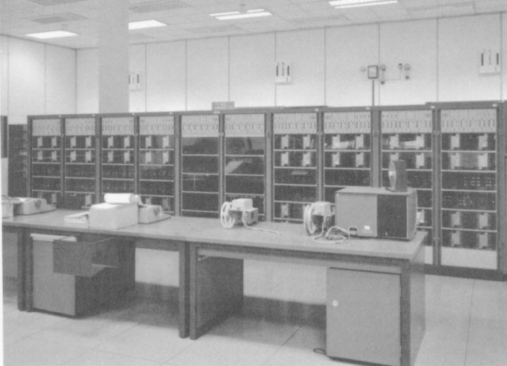

Example Batch Systems:
Telefunken TR 440
http://www.uni-saarland.de/typo3temp/pics/a3b60e2be1.jpg
© Franz J. Kurfess
http://www.vaxman.de/historic_computers/telefunken/tr440/tr440.jpg
Notes:
Telefunken TR4, predecessor of the TR440 used by the Computer Science department at the TU Munich in the late 70s/early 80s

Slide 35
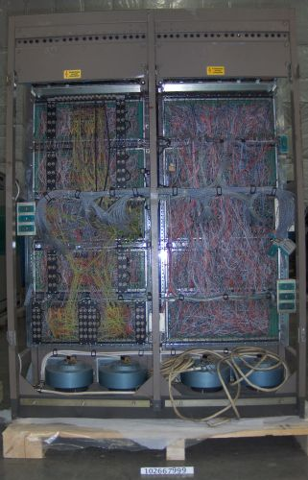
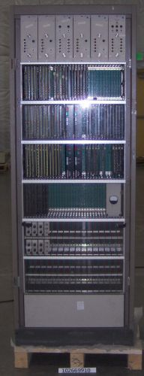
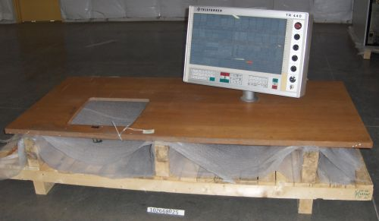
TR440
mainframe,
communications cabinet
console
http://archive.computerhistory.org/resources/physical-object/telefunken/102667999.5.lg.jpg?rand=668344533
http://archive.computerhistory.org/resources/physical-object/telefunken/102668025.1.sm.jpg

Slide 36
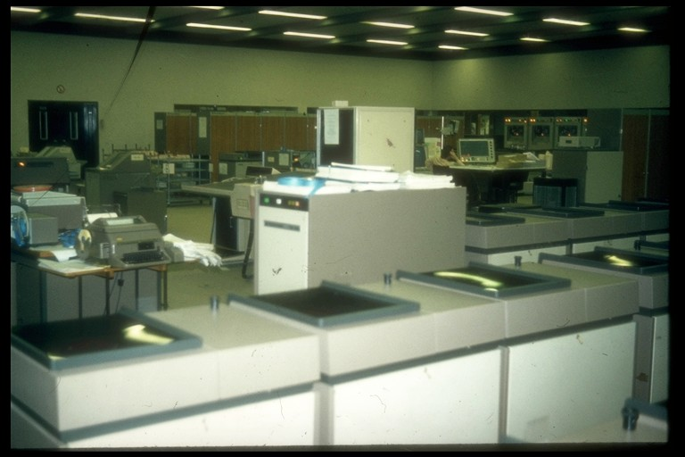
http://www.qslnet.de/member/dj4kw/lt440.jpg

Slide 37
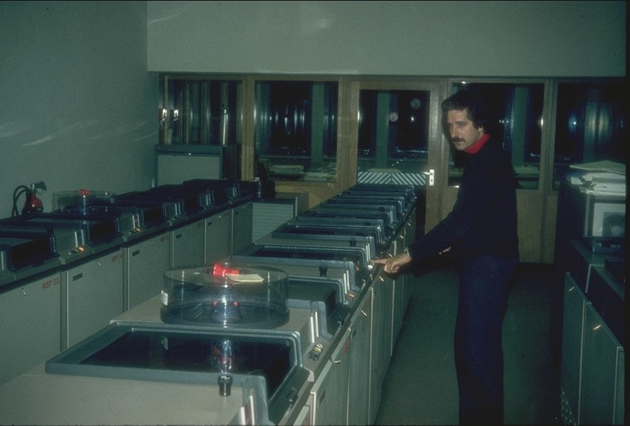
http://www.qslnet.de/member/dj4kw/lplat.jpg

Slide 38
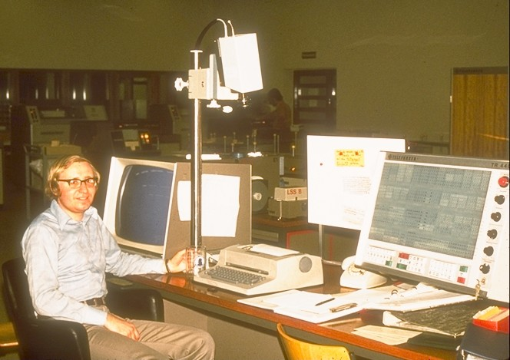
TR 440 Terminal
http://www.qslnet.de/member/dj4kw/ljim.jpg

Slide 39
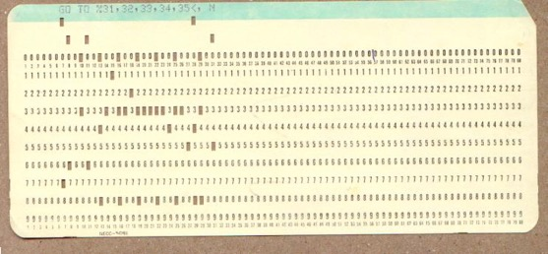
Example Batch Systems
http://www.epa.gov/athens/learn2model/part-one/career/images/card3.jpg
Notes:
Telefunken TR4, predecessor of the TR440 used by the Computer Science department at the TU Munich in the late 70s/early 80s

Slide 40
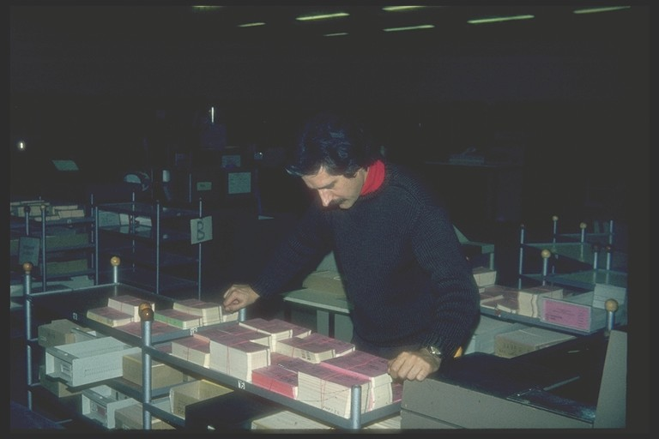
http://www.qslnet.de/member/dj4kw/lcard.jpg

Slide 41
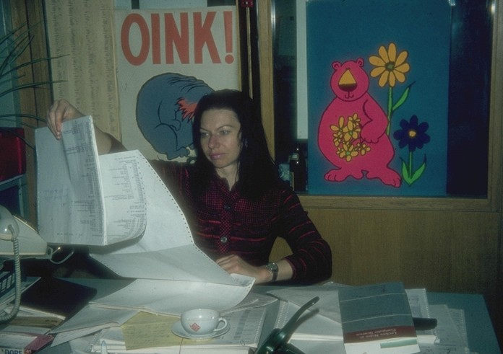
http://www.qslnet.de/member/dj4kw/loink.jpg

Slide 42
Command-Line Interfaces
also referred to as Command-Language or Line-Oriented Interfaces
A new user’s first view of almost all command-line interfaces: “>“
one-dimensional
user interacts with a system on a single line that serves as the command line
once the user hits the return key, the input can no longer be modified
typical of many early computer systems, but remain common even today
e.g., MS-DOS, UNIX
[Mustillo]

Slide 43
Command-Line Interfaces (cont.)
responsibility for navigation is on the user
user has to know what the allowable commands are
needs to have a clear idea of the function to be performed
difficult for novice users to learn
once mastered, command languages often represent the quickest form of communication
abbreviations, function keys, keyboard shortcuts,
query languages represent a special case of command languages
allow users to request information
[Mustillo]

Slide 44
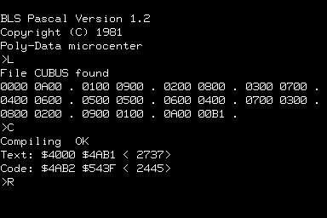
Example 1
Command-Line Interface
NASCOM-2
http://www.myplace.nu/nascom/images/simfull.jpg
Notes:
This is not a program I used, it was too expensive.
“Command line” is a bit optimistic, I believe interaction in the basic system I had was through keyboard shortcuts, function keys, and a primitive editor for machine code.

Slide 45
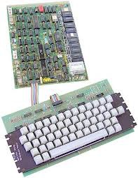
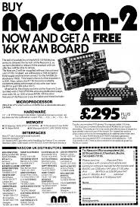
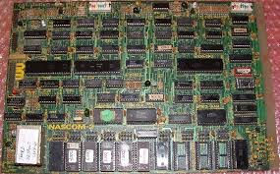
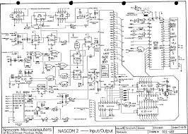
Nascom-2 Computer
http://nosher.net/archives/computers/pcw_1980-01_045
http://www.old-computers.com/museum/photos/Lucas_Nascom2_System_2.jpg
http://www.80bus.co.uk/pages/nascom/images/nascom2.jpg
http://www.freeinfosociety.com/electronics/schematics/computer/pictures/nascom2_1.gif

Slide 46
Example 2
Command-Line Interface
C > A:
A > dir
Not ready error reading drive A
Abort, Retry, Ignore? _
A typical dialog using an MS-DOS system
[Mustillo]

Slide 47
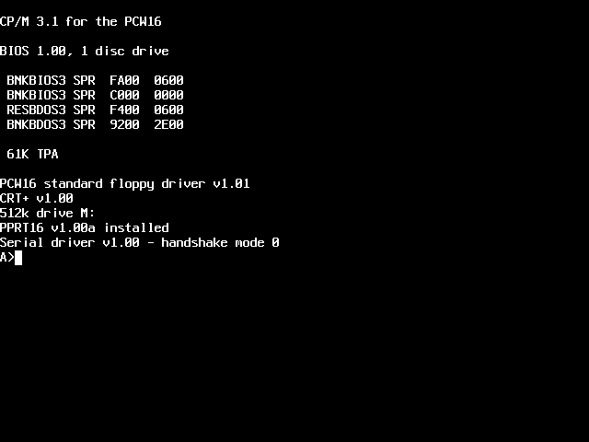
Example 3
Command Line Interface
© Franz J. Kurfess

Slide 48
Example 4
Command-Line Interface
HP-UX bmtlh730 A.09.05 A 9000/755 (ttyw0)
login: fkurfess
Password: **********
Please wait...checking for disk quotas
mtlh730:~> cokol
Enter EDMX password:
mtlh730:~> exit
A typical dialog using a UNIX system (Telnet session)

Slide 49
Advantages
Command-Line Interfaces
powerful
commands can be stringed together, automated scripts can be run, macros can be used, commands can be executed repetitively)
flexible, user controlled
users can do anything in any order
fast, efficient
requires more typing than other interaction styles, but is probably the fastest, most efficient of all interaction styles
very fast and efficient for expert, high-frequency users)
use minimal screen space
only one line at a time
[Mustillo]

Slide 50
Drawbacks
Command-Line Interfaces
operating system or program exposed to the user
difficult to learn
very cryptic, use of arbitrary syntactic delimiters, require rote memorization
difficult to remember
especially for infrequent users
rely totally on recall
inflexible
commands need to be expressed using a precise syntax
any variation represents an error
susceptible to errors, poor error handling
[Mustillo]

Slide 51
Full-Screen Interfaces
two-dimensional
user is no longer limited to a single command line, but can move around the screen along two dimensions
e.g. form-filling application, in which the user is presented with a number of labeled fields that can be edited in any sequence.
many full-screen interfaces use function keys, enumerated choices, or the first characters of a menu item as the primary interaction style
[Mustillo]

Slide 52
Example Full-Screen Interfaces
Name John Doe
City Montreal
Province Quebec
Postal Code H3E 1H6
F1 - Help
F2 - New Customer
Example of a full-screen interface
[Mustillo]

Slide 53
Menus
mechanism that allows the user to make a selection from a limited set of options
one of the most popular interaction styles
the user does not have to remember the name or abbreviation of a command
recognize it from a list of available options
names of options, contents of the icons, descriptions of buttons should be self-explanatory
[Mustillo]

Slide 54
Menu Building Blocks
menus can consist of
textual descriptions of the available functions
icons
small graphic images that represent different aspects of an interface metaphor
buttons
horizontal or vertical
boxes

Slide 55
Hierarchical Menus
most frequently used form of menus
Office
Automation
Word
Processing
Electronic
Mail
Spreadsheet
Graphics
Create
Edit
Print
File
[Mustillo]

Slide 56
Networked Menus
Office
Automation
Word
Processing
Electronic
Mail
Spreadsheet
Graphics
Help
Print
Quit
[Mustillo]

Slide 57
Menu Types
fixed menus
remain in place until the option is selected
pull-down menus (drop-down menus)
dragged down from a menu bar at the top of the screen, an item is selected, and the menu automatically returns back to its original title
pop-up menus
appear when a user clicks on a particular area of the screen, which may be designated by an icon
menu remains in place until the user instructs it to disappear, usually by clicking on a “close” box in the border of the menu’s window
cascading menus
display all options chosen one after the other in a cascading fashion
[Mustillo]

Slide 58
Design Considerations for Menus
order of items
alphabetically, by category, or by frequency
some functions should be kept apart (e.g., ‘create’ option should not be placed next to the ‘delete’ option)
selection of items
number or letter corresponding to the required option
pointing at the option using a pointing device
highlighting the item through cursor control keys
navigation through a series of menus
hierarchically-structured menus
main menu with a series of sub-menus to make further selections
[Mustillo]

Slide 59
Tradeoffs with Menus
depth vs. breadth
deep: few alternatives, many selection steps
broad: many alternatives, few selection steps
deep and narrow is often difficult for users
broad and shallow is usually easier
user does not have to go through as many levels, thereby reducing the need for user navigation
each node in the menu hierarchy becomes more complex, making the user choose between more options at each level
[Mustillo]

Slide 60
Depth and Breadth in Menus
broad menu hierarchy
deep menu hierarchy
[Mustillo]

Slide 61
Advantages of Menus
self-explanatory
require little training or learning
require little human memory
easy to remember, recognition rather than recall
indicates when parts are not relevant
interaction under user control
fast, efficient interface for experienced users
shortcuts to mouse actions
few keystrokes, which reduces errors
easy error handling
enhancements and changes are visible
[Mustillo]

Slide 62
Problems with Menus
not appropriate or efficient for some users and tasks
may slow down frequent or expert users
users may get lost in menu hierarchies
menu names may not be meaningful to users
inflexible
unless highly networked, the user is forced through set sequences of steps
impractical for numerous choices
good for a limited number of valid inputs at any given time
use lots of screen space
most effective with a pointing device
mouse, trackball, touch screen
[Mustillo]

Slide 63
Fill-in Forms
similar to a paper fill-in form
presented on a computer screen instead of paper
formatted structure containing fields, in which the user inputs data
each field has a label or caption that indicates the type of data to be entered in that field
organization and layout are important aspects
[Mustillo]

Slide 64
Example Fill-in Forms
Type in the information below.
Press TAB to move the cursor to the next field.
Press ENTER when done.
Name: ________________________ Phone: (___) ___-___
Address: ________________________
________________________
City: _________________ Province: ____ Postal Code: _______
Catalog No. Quantity Catalog No. Quantity
___________ ____________ ___________ ____________
___________ ____________ ___________ ____________
___________ ____________ ___________ ____________
___________ ____________ ___________ ____________
___________ ____________ ___________ ____________
A fill-in form interface design for a department store
[Mustillo]

Slide 65
Advantages Fill-in Forms
self-explanatory
little training or learning required
require little human memory
rely on recognition rather than recall
efficient use of screen space
multiple fields can be presented on one screen
parameters with many possible input values
e.g., names, street names, city names, postal codes, etc.
provide context
context information from other fields
enhancements and changes are visible
[Mustillo]

Slide 66
Problems Fill-in Forms
assume knowledge of valid inputs
e.g., catalog numbers, part numbers, etc.
assume typing skills
users need to know how to use TAB to move to the next field, BACKSPACE to correct
resent opportunities for making errors
inflexible
input order cannot be changed
[Mustillo]
© Franz J. Kurfess

Slide 67
Questions-and-Answer Interfaces
combine some of the features of both menus and fill-in forms in a unique dialog style
the user is faced with a single question at a time
the user has to input an answer, rather than select one from a list
system driven
the user does not have to worry about navigation.
suitable for novice or untrained users
can be frustrating to more experienced users
often the best choice for data-entry tasks performed by unskilled users
[Mustillo]

Slide 68
Example Questions-and-Answers
Canada Census 1998
Enter your name:
(Last, First, Initial)
> Kurfess, Franz, J.
Enter your marital status:
(M - married, S - single, D - divorced, W - widowed)
> M
Citizenship:
(C - Canadian, O - Other))
> O
For instructions Press HELP
To accept responses Press RETURN
To backup Press BACKSPACE
To skip a question Press RETURN
To cancel and quit Press ESC
To save and quit Press EXECUTE
[Mustillo]

Slide 69
Advantages Questions-and-Answers
self-explanatory
little training or learning required
require little human memory
recognition rather than recall
simple, non-intimidating
parameters with many possible input values
e.g., names, street names, city names, postal codes, etc.
accommodate tasks with a hierarchical structure
skip questions that do not pertain
accommodates complete and clear prompting
only one question at a time on the screen
enhancements are visible
[Mustillo]

Slide 70
Drawbacks Questions-and-Answers
inefficient
assume typing skills
opportunities for making errors
inflexible
input order cannot be changed
except in wizards, which may have a “Previous” button
no forward context
serial nature of questions may restrict context information
[Mustillo]

Slide 71
Direct Manipulation
describes the interaction between user and object
directly connects an action to an observable response from an object
follows an object-action paradigm
user performs tasks by selecting an object (e.g., icon, window, or text), and then selects an action (e.g., move, close, underline) to perform on that object
permits users to control their environment
by directly manipulating graphical objects and controls similar to those that they encounter in real life
push button starts an action
slider is used to select an analog setting, etc.
mapped onto affordances
Note: The term “direct manipulation” appeared in the 1980’s, and was reasonably descriptive at that time. Nowadays, it is a better match for touch-based or gesture-based interaction.
[Mustillo]

Slide 72
Principles of Direct Manipulation
visible objects of interest
representing an object with an icon
continuous representation of objects and actions of interest in a meaningful metaphor
objects and actions are shown
rapid, reversible, incremental actions
immediate visibility of results of actions
direct manipulation of the object of interest instead of a complex command language syntax
typing is replaced with pointing and selecting
[Mustillo]

Slide 73
Direct Manipulation Examples
name three applications or domains where direct manipulation
is appropriate
is not appropriate

Slide 74
Indirect Manipulation
in many industrial applications, objects on the computer screen stand for devices in the real world
manipulation of the screen objects may not directly constitute an identical manipulation of the real-world objects
feedback is required on two levels
directly from the user interface
indirectly, but more relevant from the real-world devices

Slide 75
Direct Manipulation Interfaces
powerful
expert users can work quickly, wide range of tasks
novice users can learn basic functionality quickly
either through self exploration or through a demonstration by a more experienced user.
no need to learn and remember complex commands
goal-oriented
users can see immediately if their actions are helping them realize their goals
if not, they can simply change the direction of their activity
error messages are rarely needed
[Shneiderman, Mustillo]

Slide 76
WIMP Interfaces
direct manipulation interfaces are characterized by
windows
to divide the screen into areas
icons representing objects
can be moved around the screen
mouse (or another pointing device)
used to manipulate objects on the screen
pop-up or pull-down menus
display the available options
[Mustillo]

Slide 77
WIMP Advantages
system as a whole is easily visible
objects are represented by icons
available menu options can be inspected by pulling down menus
basic actions are consistent across systems
opening, closing, copying, deleting, scrolling, etc.
makes learning easier
users are free to explore different aspects of the system
most actions can be ‘undone’ (reversed) if it does not have the desired or required effect
[Mustillo]

Slide 78
GUIs and Direct Manipulation
GUIs rely heavily on direct manipulation
have become synonymous with the WIMP interface
in addition to having all of the characteristics of DM and WIMP interfaces, GUIs are also strongly graphical
the primary interaction style is direct manipulation
[Mustillo]

Slide 79
Advantages of Direct Manipulation
easy to learn and remember
rely on recognition, not recall
comprehensible, predictable, and controllable
users experience less anxiety
users feel in control
visual: WYSIWYG
flexible, reversible actions
undo -> you can always choose to de-select a menu item
provide context, and instant visual feedback
exploit human use of visual-spatial cues
“a picture is worth a thousand words!”
less prone to errors
low typing requirement, visual feedback
less need for error messages
[Mustillo]

Slide 80
Problems with
Direct Manipulation
not self-explanatory
not necessarily intuitive or obvious to first-time users
users must learn meaning of the visual representation
can be inefficient for high-frequency users
same tasks much faster/ more efficient with command languages
moving a mouse and pointing slower than pressing keys
repetitive tasks
users need a macro or scripting mechanism to handle repeated manipulations
limited accuracy
pointer system may not be accurate enough or sufficiently controllable for some tasks
[Mustillo]

Slide 81
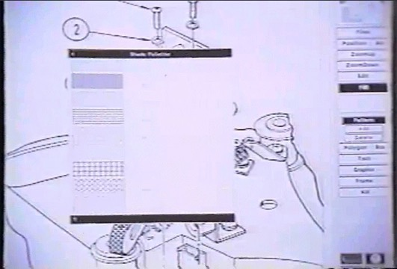
GUI Example 1
ICL/Three River PERQ workstation
http://toastytech.com/guis/perqintranvid3.jpg
Notes:
screenshot extracted from a video

Slide 82
Movie: Advanced GUI, ca 1980
a marketing movie for the INTRAN software package for scientific design on the PERQ2 workstation
http://www.youtube.com/watch?v=Fap-mXY80ls&feature=gv&hl=en
computer stuff starts around the 2:00 min mark

Slide 83
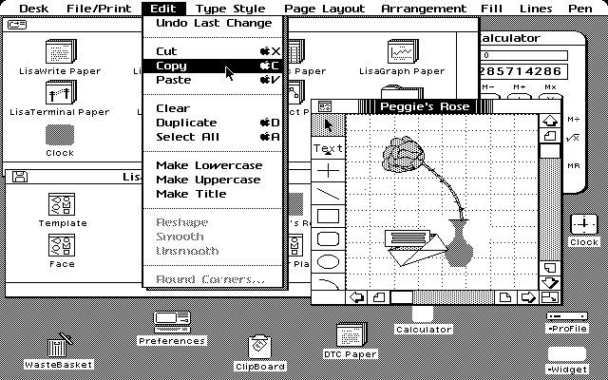
GUI Example 2
Apple Lisa
http://www.minitrue.nl/essays/vanfresconaarjpeg/graph/lisa2.gif

Slide 84
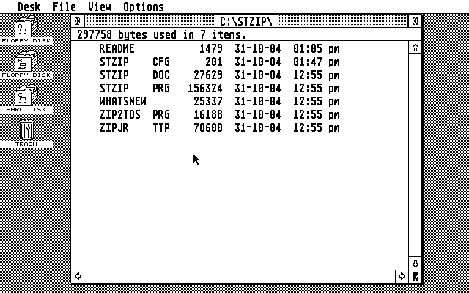
GUI Example 3
Atari TOS
http://upload.wikimedia.org/wikipedia/en/0/07/ST_Desktop.png

Slide 85
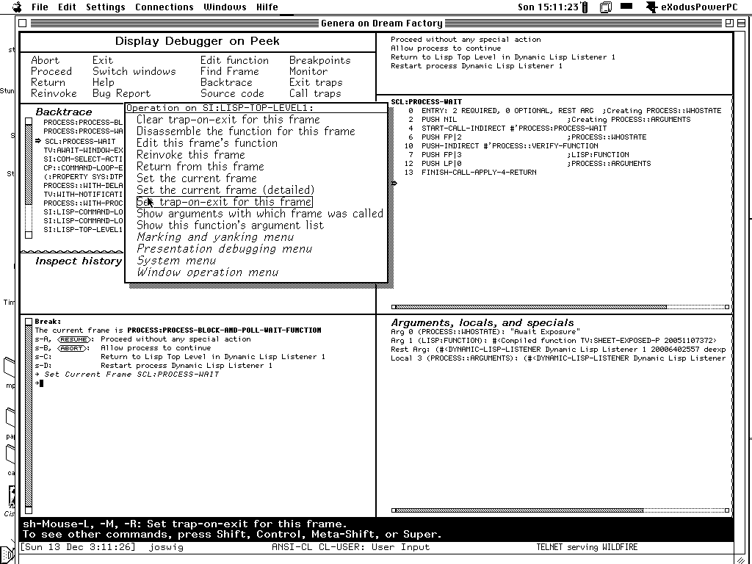
GUI Example 4
Symbolics Lisp Machine (Macivory)
http://upload.wikimedia.org/wikipedia/en/f/f6/Debugger.gif
© Franz J. Kurfess

Slide 86
Natural Language Interaction
natural language (NL) to communicate and interact with a computer system
Such a system would have to be able to handle the vagueness, ambiguity, and ungrammatical constructions associated with natural language
ideally, a NL dialog should be based on speech input
speech recognition technology is still far from being perfect
users may have to rely on typing, which has its own problems
spelling errors, slow, verbose
not very widely accepted
[Mustillo]

Slide 87
Non-command Interfaces
no explicit commands
computer interprets observations of the user
ubiquitous computing, immersive computing
gesture recognition, user observation
intelligent agents, user preferences

Slide 88
Selection of Interaction Styles
considerations
who has control
ease of use for novice users
learning time to become proficient
speed of use (efficiency) once users become proficient
generality, flexibility, power
task requirements
user background
[Mustillo]

Slide 89
Task Requirements
high degree of data entry is required
fill-in forms are recommended, but a command-line interface may also be used
familiar notation exists
use a command-line interface
visual exploration is required
use a direct manipulation interface
users have poor keyboard skills
rely on menu selection and direct manipulation
[Mustillo]

Slide 90
User Background
novice users
use menu selection and direct manipulation
modest domain knowledge, some computer skills
use menu selection, direct manipulation, or fill-in forms
users work with the application on an intermittent basis
any interaction style may be used, but some form of help (user guide, on-line) may also be required
frequent users
use a command-line interface with macros, menu selection with type-ahead capability, direct manipulation with shortcuts, or a fill-in form with a dense display
[Mustillo]

Slide 91
Mobile Devices
Usage
Capabilities
Advantages
Limitations

Slide 92
Mobile Devices - Usage
often closer proximity to users
with the user most of the time
easy to carry
often multi-purpose devices
mobile phone, music player, camera, hand-held computer
essential professional or personal device
connectivity (phone, text messaging, email, Web)
organization (calendar, to do list, contacts, directions)
pleasure (music, photos, videos, e-books)

Slide 93
Mobile Devices - Capabilities
I/O capabilities
input
control and navigation (buttons; no mouse; cursor keys or limited pointing device; touch screen; gyroscope or accelerometer)
text (keyboard missing or small)
speech (microphone/head set)
output
visual: small screen
audio: small speaker, headphones
haptic: vibration
computational capabilities
limited memory, processing
connectivity
wired (USB)
wireless (cellular, Wi-Fi, Bluetooth, Infrared)

Slide 94
Mobile Devices - Advantages
quick & easy access
multiple functions in one device

Slide 95
Mobile Devices - Limitations
input and output constraints
buttons, keyboard, navigation
screen size
functional constraints
available functions are sometimes not very sophisticated
proprietary or unusual interaction methods
touch gestures, (virtual) keyboard arrangement
synchronization with other devices
computer, home phone, car, …

Slide 96
Speech-Based Interaction
command-based
limited vocabulary
keywords or phrases
requires recall
dictation
speech to text conversion
spoken output
often used to augment or replace visually displayed text
queries
very large to unlimited vocabulary
phrases or sentences
often formulated as questions
conversation
ongoing interaction among conversation participants

Slide 97
Natural User Interfaces
utilization of interaction methods users are familiar with
“real-world”
task-specific
often gestures
discussed in a separate chapter later

Slide 98
Ubiquitous and Pervasive Computing
overlap with Internet of Things (IoT)
Usage
Capabilities
Advantages
Limitations

Slide 99
Ubiquitous Computing – Usage
task-specific devices with computing capabilities
entertainment systems
home security
phone
car navigation systems
core functionality augmented by computational capabilities
connectivity
additional functionality
better interaction

Slide 100
Ubiquitous Computing - Capabilities
core capabilities defined by the application are or task
often very limited
sometimes augmented for better functionality or interaction
Input
often buttons, remote control
Output
screen, audio, actuators (performing specific functions)
computational capabilities
often embedded microprocessors

Slide 101
Ubiquitous Computing - Advantages
familiar devices and tasks
added functionality for such devices
better interaction with devices
e.g. Tivo vs. VCR
connectivity between computers and household or personal devices

Slide 102
Ubiquitous Computing - Limitations
limited computational capabilities
limited interaction methods
coordination and synchronization

Slide 103
Intelligent Agents
user conveys intentions
goals
critical parameters
computer handles mundane and tedious activities
repetitive
easy to automate
less, but more effective interaction
computer acts more autonomously

Slide 104
Overview Interaction Styles
Interaction Style
Batch
Command language
Fill-in Form
Question-and-Answer
Menu
Direct Manipulation
Non-Command
Natural Language
Mainly used In
Batch processing, e-mail
servers
Command-line interfaces
Full-screen interfaces
Command-line interfaces
Full-screen, WIMP, telephone-based interfaces
WIMP, virtual reality interfaces
Future interfaces, virtual reality
interfaces
Future interfaces
Main Characteristics
Does not require user intervention. Works even when user and computer are in a different time or place.
Easy to edit and reuse command history. Powerful
language can support very complex operations.
Many fields can be seen and edited at once.
Computer controls the user. Suited for casual use.
Frees user from remembering options, at cost of
potentially being slow or having confusing hierarchy.
User is in control. Enables metaphors from real world. Good for graphics.
User is freed to concentrate on the domain, and need to control the computer. Computer monitors users and interprets their actions.
Ideally, allows unconstrained input to handle frequently challenging problems.
[Mustillo]

Slide 105
Conclusions Interaction Styles
many interaction styles
not always possible to draw clear, unambiguous distinctions between different interaction styles
the selection of an appropriate interaction style depends on many factors
application, users, characteristics
tasks
simple, walk-up-and-use vs. browsing and data entry
time to complete the tasks
accuracy to complete the tasks
levels of experience
[Mustillo]

Slide 106
Post-Test
Notes:
evaluate the learning success of the participants
provide feedback to the students about their achievements
ask for feedback on unclear or difficult parts
point out possible gaps and difficulties
encourage suggestions for improvement

Slide 107
Evaluation
Criteria

Slide 108
Important Concepts and Terms
batch system
command-line interface
contextual task analysis
desktop
direct manipulation
forms
full-screen interface
goal
graphical user interface (GUI)
heuristic evaluation
hierarchical menu
human-machine interface
intelligent agent
interaction style
menu
mouse
natural language
networked menu
system language
task
task analysis
usability
user-centered design
user interface design
user language
user requirements
What You See Is What You Get” (WYSIWYG)
WIMP
window

Slide 109
Chapter Summary
practically all current interaction styles are variations of command-based interfaces
the currently predominant interaction style with computers is the WIMP interface
windows, icons, mouse, pull-down menus
mobile technology is taking over more tasks
the selection among various possible interaction styles depends on user background, task requirements, technology, and economical factors
emerging technologies like natural language processing or intelligent agents may cause a shift towards non-command interfaces

